Slide 1
Content Monetization Modeler
YouTube Ad Revenue Prediction Using Machine Learning
Submitted by: Kaviya V
Batch Code: DS-S-WD-T-B94
Course: Data Science

Slide 2
agenda
Executive Summary
Project Objective
Dataset Description
Tools & Technologies
Data Pipeline Overview
Exploratory Data Analysis (EDA)
Feature Engineering
Model Building
Model Evaluation
Streamlit Application Overview
Insights, Recommendations, Conclusion
& Future Enhancements

Slide 3
1. Executive Summary
This project focuses on predicting YouTube ad revenue using machine learning techniques based on video performance and engagement metrics.
The solution helps content creators and media companies understand revenue patterns and optimize content strategy.
The system uses Python for data processing, machine learning for prediction, and Streamlit for interactive visualization.
2. Project Objective
Build a machine learning model to predict YouTube ad revenue
Analyze video performance and engagement factors
Identify key features influencing revenue
Provide an interactive web application for predictions
Support data-driven content monetization decisions
3

Slide 4
3. Dataset Description
Synthetic YouTube monetization dataset
Each row represents a video’s daily performance
Includes numerical and categorical features
Key Columns:
views, likes, comments
watch_time_minutes, video_length_minutes
subscribers
category, device, country
ad_revenue_usd (Target Variable)
4. Tools & Technologies
Python – Data cleaning, feature engineering, modelling
Pandas & NumPy – Data manipulation
Seaborn & Matplotlib – Visualization
Scikit-learn – Machine learning models
Streamlit – Web application deployment

Slide 5
5. Data Pipeline Overview
Step 1: Load raw dataset
Step 2: Clean and preprocess data
Step 3: Perform exploratory data analysis
Step 4: Feature engineering
Step 5: Train and evaluate models
Step 6: Select the best model
Step 7: Deploy model using Streamlit
6. Exploratory Data Analysis (EDA)
Checked missing values and duplicates
Analyzed distribution of numerical features
Studied trends across date, category, device, and country
Performed correlation analysis with the target variable
Visualized revenue distribution and patterns
7. Feature Engineering
Created engagement-based features:
Engagement Rate
Likes per View
Comments per View
Watch Time Ratio
Encoded categorical variables
Scaled numerical features
Prepared final dataset for modeling

Slide 6
8. Model Building
One-to-many relationships created from dimensions to the fact table
Train-test split (80% training, 20% testing)
Tested multiple regression models:
Linear Regression
Ridge Regression
Lasso Regression
Random Forest Regressor
Gradient Boosting Regressor
9. Model Evaluation
Evaluation Metrics Used:
R² Score
Root Mean Squared Error (RMSE)
Mean Absolute Error (MAE)
Compared all models using metrics
Gradient Boosting Regressor achieved the best performance
Selected as the final model

Slide 7
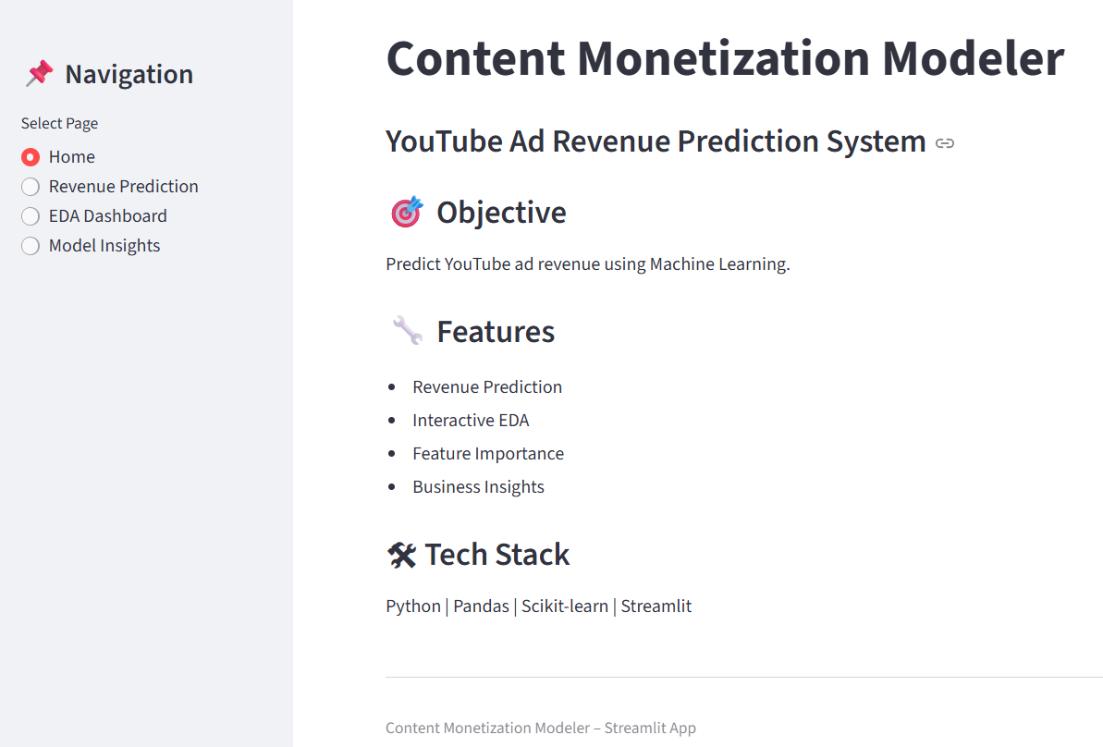
10. Streamlit Application Overview
The Streamlit application provides an interactive interface for users to explore data, predict revenue, and understand model insights.
Home Page
Displays project title and description
Shows the objective of predicting YouTube ad revenue
Lists key features of the application
Highlights the technology stack used
Navigation Panel:
Home
Revenue Prediction
EDA Dashboard
Model Insights

Slide 8
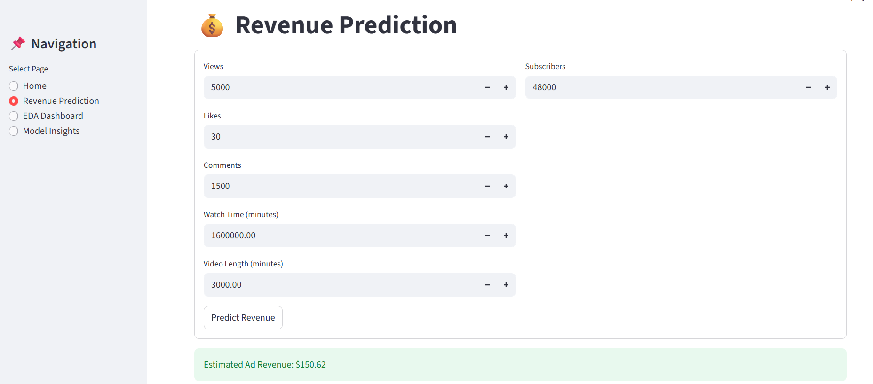
Revenue Prediction Page
User enters video performance details:
Views
Likes
Comments
Watch Time
Video Length
Subscribers
System automatically calculates engagement features
Trained model predicts estimated ad revenue

Slide 9
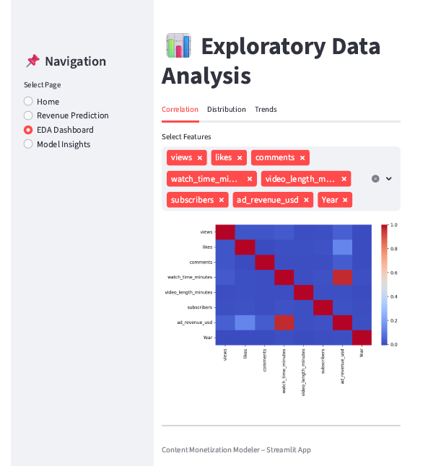
EDA Dashboard Page
Correlation Tab:
  Users select numerical features
  Heatmap shows the relationship between variables
Distribution Tab:
  Users select any metric
  Histogram displays its distribution
Trends Tab:
  Users select Category / Device / Country
  The bar chart shows revenue trends

Slide 10
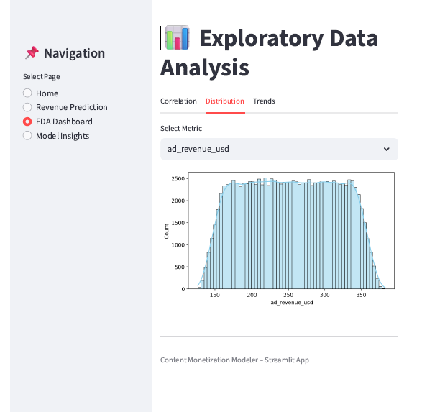
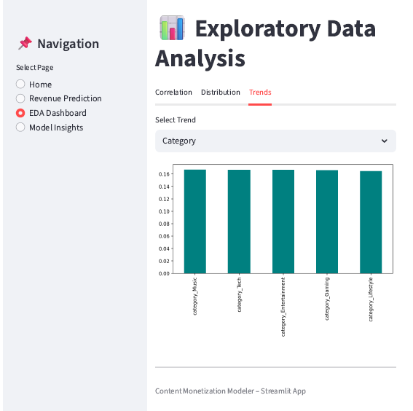

Slide 11
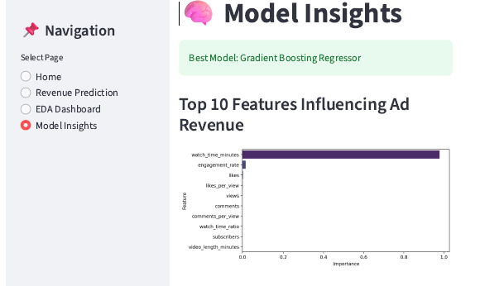
Model Insights Page
Displays best-performing model
Shows Top 10 features influencing ad revenue
Summarizes key findings
Explains business impact
Benefits of the Application
Easy-to-use interface
Supports data-driven decisions
Helps creators estimate earnings
Provides visual analytics

Slide 12
Key Insights
Recommendations
Views and watch time strongly influence revenue
Engagement metrics improve monetization
Subscriber base supports stable earnings
Content category, device, and country impact CPM
Focus on content that increases watch time
Encourage audience engagement (likes & comments)
Target high-performing categories and regions
Use predictions to plan upload strategy
Conclusion
Future Enhancement
The project successfully builds a machine learning system to predict YouTube ad revenue and provide actionable insights for content monetization.
The Streamlit application makes predictions and analytics easily accessible.
Add real-time data integration
Implement deep learning models
Include revenue forecasting over time
Add user authentication to app

